Slide 1
CS595—Big Data Technologies
Module 15
NoSQL Document Database
MongoDB (Part 2; Architecture, Aggregation)
Polyglot Persistence

Slide 2
Architecture

Slide 3
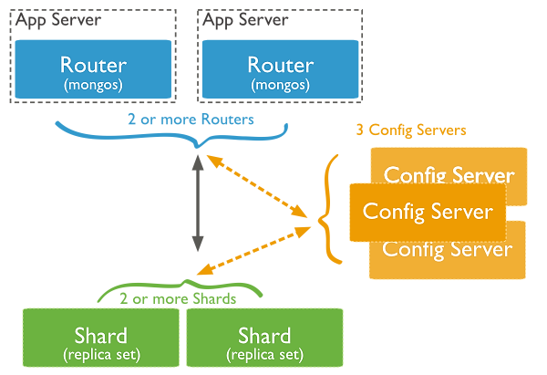
Architecture
Replica set (master / slave)
Shard (replica set within a cluster)
Config server (topology)
Mongos (router)
Shard key is an indexed field that determines o which shard a particular document belongs

Slide 4
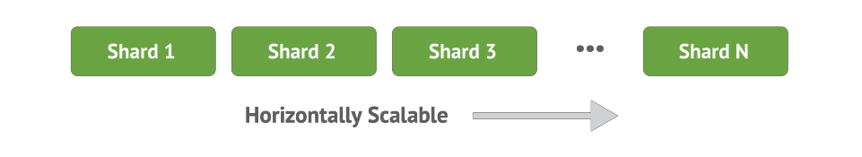

Architecture
Auto-Sharding
Increase capacity as you go
Commodity and cloud architectures
Improved operational simplicity and cost visibility
Into petabytes, millions ops/sec, thousands of nodes

Slide 5
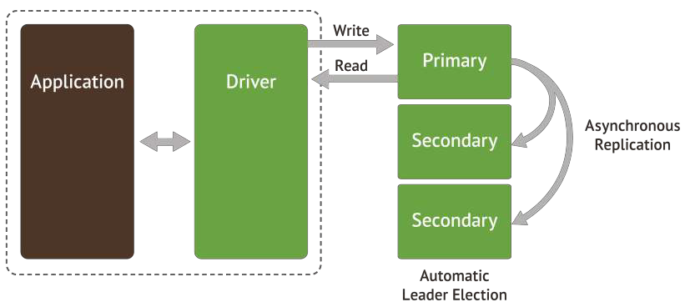
Architecture
Automated replication and failover
Multi-data center support
Improved operational simplicity (e.g., HW swaps)
Data durability and consistency

Slide 6
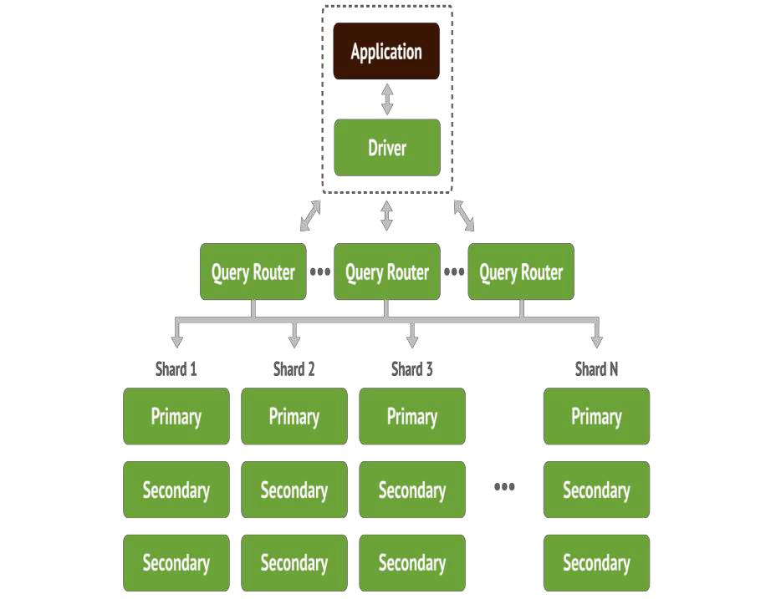
MongoDB Architecture

Slide 7
Aggregation Framework

Slide 8

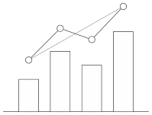


Analytics in MongoDB?
Analytics
?
Create Read Update Delete
Group Count
Derive Values Filter Average
Sort

Slide 9
Aggregation in Nutshell
We're storing our data in MongoDB
Our applications need to run ad-hoc queries for grouping, summarizations, reporting, etc.
We must have a way to reshape data easily to support these access patterns
You can use the aggregation framework for this

Slide 10
Aggregation Framework
Modeled on the concept of data processing pipelines
Documents enter a multi-stage pipeline that transforms the documents into aggregated results
The MongoDB aggregation pipeline consists of stages
Each stage transforms the documents as they pass through the pipeline

Slide 11

What is an Aggregation Pipeline?
A Series of document transformations
Executed in stages
Original input is a collection
Output as a cursor or a collection
Rich Library of Functions
Filter, compute, group, and summarize data
Output of one stage sent to input of next
Operations executed in sequential order

Slide 12
Aggregation Framework
To get an aggregation pipeline started call the aggregate function on any collection
db.collection.aggregate([ ... aggregation steps go here ...])
Accepts an array of data transformations which are applied to the data in the order they're defined
Transformations listed first will be executed first and the result will be used by next transformation in sequence

Slide 13
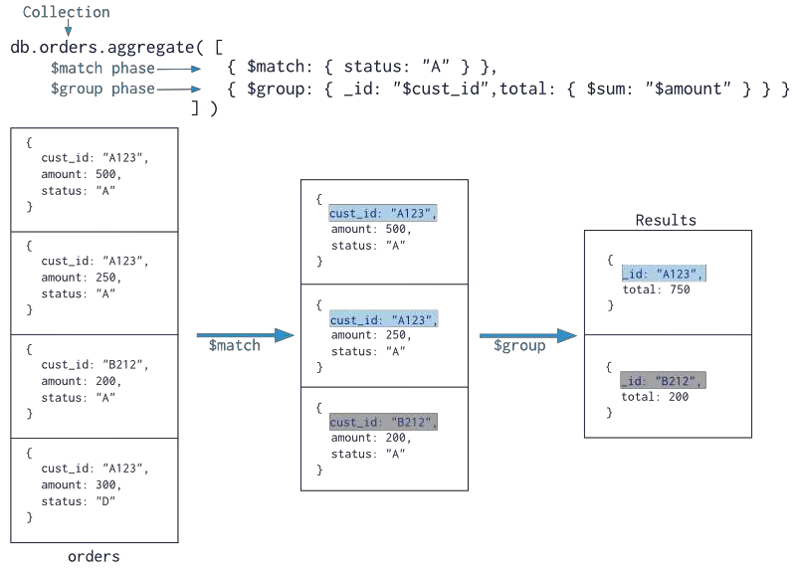
Aggregation Pipeline

Slide 14
Aggregation Pipeline

Slide 15
Pipeline Operators
$match
Filter documents
$project
Reshape documents
$group
Summarize documents
$unwind
Expand documents
$sort
Order documents
$limit / $skip
Paginate documents
$redact
Restrict documents
$geoNear
Proximity sort documents
$let, $map
Define variables

Slide 16
$match
Filter documents
Uses existing query syntax
No geospatial operations or $where

Slide 17







Matching FieldValues
{ subject: "Hello There", words: 218, from: "norberto@mongodb.com" }
{ subject: "I love Hofbrauhaus", words: 90, from: "norberto@mongodb.com" }
{ subject: "MongoDB Rules!", words: 100, from: "hipster@somemail.com" }
{ $match: {
from: "hipster@somemail.com"
}}
{
subject: "MongoDB Rules!",
words: 100,
from: "hipster@somemail.com"
}

Slide 18

{ $match : { language : "Russian" } }
{
title: "The Great Gatsby", pages: 218,
language: "English"
}
{
title: “War and Peace", pages: 1440, language: ”Russian"
}
{
title: “Atlas Shrugged", pages: 1088, language: ”English"
}

Slide 19
{ $match : { pages : { $gt : 1000 }, language : "Russian" } }
{
title: "The Great Gatsby", pages: 218,
language: "English"
}
{
title: “War and Peace", pages: 1440, language: ”Russian"
}
{
title: “Atlas Shrugged", pages: 1088, language: ”English"
}

Slide 20
$project
Reshape documents
Include, exclude or rename fields
Inject computed fields
Create sub-document fields

Slide 21
Selecting and Excluding Fields
$project: { _id: 0, title: 1, language: 1 }
{
_id: 375,
title: "Great Gatsby",
ISBN: "9781857150193",
available: true, pages: 218, subjects: [ "Long Island", "New York", "1920s"
],
language: "English"
}
{
title: "Great Gatsby", language: "English"
}

Slide 22




Including and Excluding Fields
{
_id: 12345,
subject: "Hello There", words: 218,
from:"norberto@mongodb.com" to: [ "marc@mongodb.com",
"sam@mongodb.com" ], account: "mongodb mail", date: ISODate("2012-08-05"),
replies: 3, folder: "Inbox",
...
}
{ $project: {
_id: 0,
subject: 1,
from: 1
}}
{
subject: "Hello There", from:"norberto@mongodb.com"
}

Slide 23



Renaming and Computing Fields
{
_id: 12345,
subject: "Hello There", words: 218,
from:"norberto@mongodb.com" to: [ "marc@mongodb.com",
"sam@mongodb.com" ], account: "mongodb mail", date: ISODate("2012-08-05"),
replies: 3, folder: "Inbox",
...
}
{ $project: { spamIndex: {
$mul: ["$words",
"$replies"]
},
user: "$from"
}}
{
_id: 12345,
spamIndex: 72.6666 ,
user: "norberto@mongodb.com"
}

Slide 24
Renaming and Computing Fields
New Field
{ $project: { avgChapterLength: {
$divide: ["$pages",
"$chapters"]
},
lang: "$language"
}}
{
_id: 375,
title: "Great Gatsby",
ISBN: "9781857150193",
available: true, pages: 218, subjects: [ "Long Island", "New York", "1920s"
],
language: "English"
}
{
_id: 375,
avgChapterLength: 24.2222, lang: "English"
}

Slide 25
Renaming and Computing Fields
{
_id: 12345,
subject: "Hello There", words: 218,
from:"norberto@mongodb.com" to: [ "marc@mongodb.com",
"sam@mongodb.com" ], account: "mongodb mail", date: ISODate("2012-08-05"),
replies: 3, folder: "Inbox",
...
}
{ $project: { spamIndex: {
$mul: ["$words",
"$replies"]
},
user: "$from"
}}
{
_id: 12345,
spamIndex: 72.6666 ,
user: "norberto@mongodb.com"
}

Slide 26
Creating Sub-Document
Fields
$project: { title: 1,
stats: { pages: "$pages”, language: "$language” } }
{
_id: 375,
title: "Great Gatsby", ISBN: "9781857150193",
available: true, pages: 218, subjects: [ "Long Island", "New York", "1920s"
],
language: "English"
}
{
_id: 375,
title: "Great Gatsby", stats: {
pages: 218, language: "English"
}
}

Slide 27


Creating Sub-Document Fields
{
_id: 12345,
subject: "Hello There", words: 218,
from:"norberto@mongodb.com" to: [ "marc@mongodb.com",
"sam@mongodb.com" ], account: "mongodb mail", date: ISODate("2012-08-05"),
replies: 3, folder: "Inbox",
...
}
{ $project: { subject: 1, stats: {
replies: "$replies",
from: "$from", date: "$date"
}}}
{
_id: 375,
subject: "Hello There", stats: {
replies: 3,
from: "norberto@mongodb.com",
date: ISODate("2012-08-05")
}}

Slide 28
$group
Group documents by an ID
Field reference, object, constant
Other output fields are computed
$max, $min, $avg, $sum
$addToSet, $push
$first, $last
Processes all data in memory

Slide 29







Calculating An Average
{
subject: "Hello There",
words: 218,
from: "norberto@mongodb.com"
}
{ $group: {
_id: "$from", avgWords: { $avg:
"$words" }
}}
{
subject: "I love Hofbrauhaus",
words: 90,
from: "norberto@mongodb.com"
}
{
_id: "norberto@mongodb.com",
avgPages: 154
}
{
subject: "MongoDB Rules!",
words: 100,
from: "hipster@somemail.com"
}
{
_id: "hipster@somemail.com", avgPages: 100
}

Slide 30
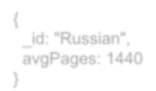


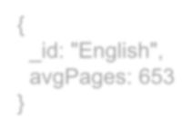
$group: {_id: "$language”, avgPages: { $avg:"$pages"}}
{
title: "The Great Gatsby",
pages: 218,
language: "English"
}
{
title: "War and Peace",
pages: 1440,
language: "Russian"
}
{
title: "Atlas Shrugged",
pages: 1088,
language: "English"
}
{
_id: "Russian", avgPages: 1440
}
{
_id: "English", avgPages: 653
}

Slide 31


Summing Fields and Counting
{
subject: "Hello There",
words: 218,
from: "norberto@mongodb.com"
}
{ $group: {
_id: "$from",
words: { $sum: "$words" }, mails: { $sum: 1 }
}}
{
subject: "I love Hofbrauhaus",
words: 90,
from: "norberto@mongodb.com"
}
{
_id: "norberto@mongodb.com", words: 308,
mails: 2
{
}
subject: "MongoDB Rules!", words: 100,
from: "hipster@somemail.com"
{
_id: "hipster@somemail.com", words: 100,
mails: 1
}
}

Slide 32
$unwind
Operate on an array field
Yield new documents for each array element
Array replaced by element value
Missing/empty fields → no output
Non-array fields → error
Pipe to $group to aggregate array values

Slide 33
$unwind Operator
Decompose the embedded array into flat document and relate each entry in the array with outer fields.
Example :-
{ _id: “blog”, tags: [ “social”, “economic” ] }
{ _id: “blog”, tags: “social” }
{ _id: “blog”
tags: “economic” }

Slide 34


Collecting Distinct Values
{
_id: 2222,
subject: "2.8 will be great!", to: [ "marc@mongodb.com",
"eliot@mongodb.com", "asya@mongodb.com",
],
account: "mongodb mail"
}
{ $unwind: "$to" }
{ subject: "2.8 will be great!", to: "marc@mongodb.com", account : "mongodb mail” }
{ subject: "2.8 will be great!", to: "eliot@mongodb.com", account : "mongodb mail” }
{ subject: "2.8 will be great!", to: "asya@mongodb.com", account : "mongodb mail” }

Slide 35
$sort, $limit, $skip
Sort documents by one or more fields
Same order syntax as cursors
Waits for earlier pipeline operator to return
In-memory unless early and indexed
Limit and skip follow cursor behavior

Slide 36




















$sort, $limit, $skip
{ $sort: { title: 1 }}
{ title: ”The Great Gatsby" }
{ title: ”Animal Farm" }
{ title: ”Brave New World" }
{ title: ”Brave New World" }
{ title: ”Grapes of Wrath” }
{ title: ”Fathers and Sons” }
{ title: ”Animal Farm" }
{ title: ” Grapes of Wrath" }
{ title: ”Lord of the Flies" }
{ title: ”Invisible Man" }
{ title: ”Father and Sons" }
{ title: “Lord of the Flies" }
{ title : “Invisible Man” }
{ title : “The Great Gatsby” }

Slide 37
SQL to Aggregation Mapping
In SQL | In MongoDB | Description
Select | $project | Passes the fields to next stage with existing Fields or with New fields.We can add new Fields dynamically
Where | $match | This will filter the documents and will pass only matching documents to next pipeline stage.
Limit | $limit | limit the first x unmodified documents and pass them to next stage of pipeline. x is the number of the documents which will pass through the next stage of pipeline.
GroupBy | $group | This will group the documents and pass them to the next stage of Aggregation pipeline.
OrderBy | $sort | It will change the order of documents either in ascending or descending.
Sum | $sum | To calculate the sum of all the numeric values.
Join | $lookup | It will perform the left outer join with another collection in same database.

Slide 38
Examples
SQL Query | Aggregation Query
SELECT COUNT(*) AS COUNT FROM EMPLOYEE | db.employee.aggregate([ {$group: {_id:null, count: { $sum:1} } } ]) Explaination : Group by : on nothing Sum : Just add 1 to count field for each record
SELECT SUM(SALARY) AS TOTAL FROM EMPLOYEE | db.employee.aggregate([ {$group: {_id:null, total: { $sum:”$salary”} } } ]) Explaination : Group by : on nothing Sum: do the sum of value of salary field of each doc and put result in total.

Slide 39
Example Cont.
SELECT DEPARTMENT_ID, SUM(SALARY) AS TOTAL FROM EMPLOYEE GROUP BY DEPARTMENT_ID ORDER BY TOTAL
db.employee.aggregate( [
{ $group: { _id: “$department_id”, total:
{ $sum:”$salary” } },
{ $sort: { total : 1 } } }
] )
Explanation:
Group by : department, Sum : salary,
Order by : total of salary for each department

Slide 40
Example Cont.
SELECT DEPT_ID, SUM(SALARY) AS TOTAL FROM EMPLOYEE WHERE AGE>25 GROUB BY DEPT_ID, HAVING TOTAL > 5000
db.employee.aggregate( [
{ $match : { age : {$gt: 25 } } }
{ $group: { _id: “$dept_id”, total:
{ $sum: ”$salary” } } },
{ $match: { total: {$gt:5000 } } }
] )
Explanation:
Group by : department id, Sum : salary,
Having: on total of each department salary

Slide 41
Example Cont.
SELECT DEPT_ID, SUM(SALARY) AS TOTAL FROM EMPLOYEE WHERE AGE>25 GROUB BY DEPT_ID, HAVING TOTAL > 5000
db.employee.aggregate( [
{ $match : { age : {$gt: 25 } } }
{ $group: { _id: “$dept_id”, total:
{ $sum: ”$salary” } } },
{ $match: { total: {$gt:5000 } } }
] )
Explanation:
Group by : department id, Sum : salary,
Having: on total of each department salary

Slide 42
Polyglot Persistence

Slide 43
pol●y●glot - Adjective
Knowing or using several languages

Slide 44
pol●y●glot - Adjective
Knowing or using several languages
per●sist●ence - Noun
The continued or prolonged existence of something

Slide 45
Polyglot Persistence
The continued or prolonged existence of something using several languages

Slide 46
Polyglot Persistence
The continued or prolonged existence of something using several languages databases

Slide 47
Polyglot Persistence
Using multiple data storage technologies, chosen based upon the way data is being used by individual applications or components of single application.
Martin Fowler http://martinfowler.com/articles/nosql-intro.pdf

Slide 48
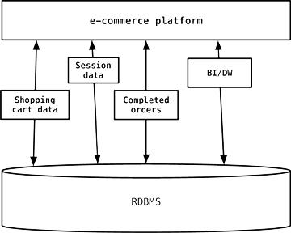
Relational Database (RDBMS) Storage
Enterprises tend to use the same database engine to store business transactions, session management data, and for other storage needs

Slide 49
Why Use an RDBMS
Widely used and understood Tested in real environments
Efficient use of storage space if data normalized properly Great tools support
ACID semantics
Incredibly flexible and powerful query language Great framework support
●
●
●
●
●
●
●

Slide 50
RDBMS Limitations
●
Complex object graphs does not map very well with flat tables.
Difficult to evolve Schema with time.
Data constraints and JOINs can be expensive at runtime. Difficult to scale horizontally.
●
●
●

Slide 51
NoSQL Benefits
Schema-less Eventual consistent
Scales writes and reads
Easy to scale horizontally to add processing power and storage
Tries to solve few practical use-cases
●
●
●
●
●

Slide 52
But The RDBMS Is Far From Dead
Incredibly mature, and battle tested Immediate and constant consistency Integrity of data is enforced
Efficient use of storage space if data normalized properly
Supported by everyone and everything (tools, frameworks, libraries, etc)
Incredibly flexible and powerful query language Help is plentiful and easy to find
●
●
●
●
●
●
●

Slide 53
Multiple Technology Data Storage
Let’s take our e-commerce example and use polyglot persistence to see how some other data stores can be applied

Slide 54
CS595—Big Data Technologies
Module 15
NoSQL Document Database
MongoDB (Part 2; Architecture, Aggregation)
Polyglot Persistence

Slide 55

Single Engine Data Storage
Enterprises tend to use the same database engine to store business transactions, session management data, and for other storage needs

Slide 56
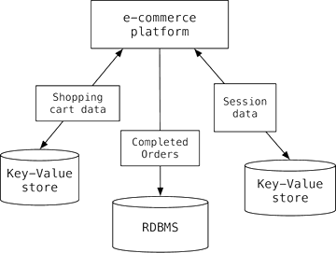
Polyglot Data Storage
But the session, shopping cart, or order data do not need the same properties of availability, consistency, or backup requirements

Slide 57






















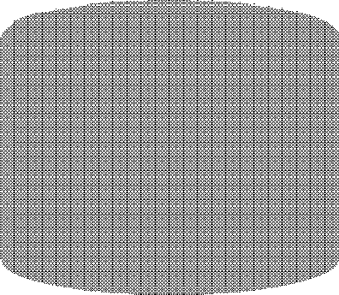


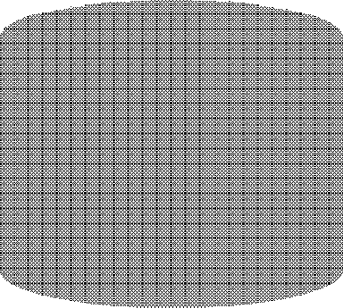
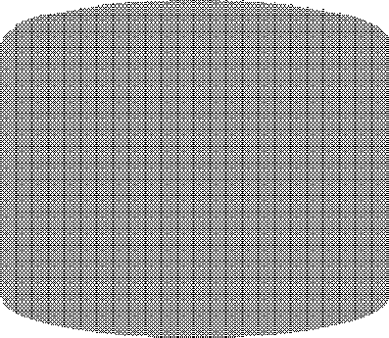

The Big Picture
Applications
Session data
Logs
Product info
Customer Agent relation- ships
Price analytics
XA data
Price updates
Oper. analytics
Key/Value
Columnar
Document
Graph
Hadoop
RDB

Slide 58









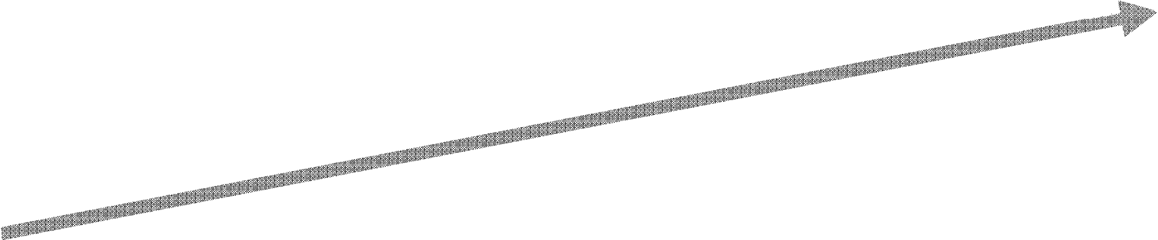

NoSQL Impact
Relational Database
Doable, but More
Expensive and Slow
Enable Unlimited
Volume Growth
Cost / Performance
Stabilize Cost &
Increase Performance
NoSQL
Processors Disks
1M
x1000
1B
x1000
1T
x1000
1Q
x1000 …HUGE!!!

Slide 59
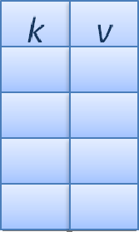
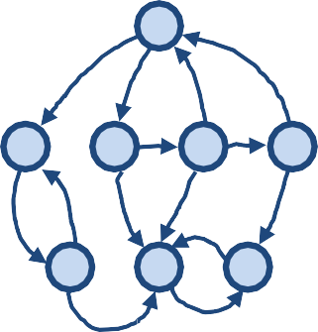
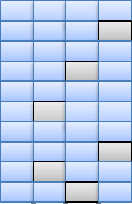




NoSQL Stores and Categories
Column- Family
Document- Oriented
Key-Value
Graph DB
Choose a store that is a best match for your application
It is fine to have several different stores used
– "Polyglot persistence"

Slide 60
Taxonomy

Slide 61
Key-­Value Stores

Slide 62
distributed hash tables

Slide 63
Performance Scalability Flexibility Complexity Functionality
high high high none
variable (none)

Slide 64
DynamoDB Redis
Riak

Slide 65
Column-­Oriented Stores

Slide 66
semi-­structured

Slide 67
Performance Scalability Flexibility Complexity Functionality
high high
moderate low minimal

Slide 68
Cassandra HBase

Slide 69
Document-­‐Oriented Stores

Slide 70
also semi-­‐structured

Slide 71
Performance Scalability Flexibility Complexity Functionality
high
variable (high) high
low
variable (low)

Slide 72
CouchDB MongoDB

Slide 73
Graph Databases

Slide 74
graph theory

Slide 75
Performance Scalability Flexibility Complexity Functionality
variable variable high high
graph theory

Slide 76
AllegroGraph Neo4J

Slide 77
Relational Databases

Slide 78
Performance Scalability Flexibility Complexity Functionality
variable variable low moderate
relational algebra

Slide 79
Well known layers
Presentation Layer
Domain Layer
Resource Access Layer ( Data Access Layer) Resources

Slide 80
Common data tier design
Presentation
User Interface
Domain
Object-Relational
Relational-Object
Search
Caching
Triggers
DAL
Transactions
Blobs
Reporting
Resources
RDBMS

Slide 81
Data access with reusable and seamless services
Presentation
User Interface
Domain
Search
Caching
Batch
Transactions
Blobs
Reporting
DAL
Resources
Key-Value Document RDBMS

Slide 82
Putting all together
User Interface
Middle Tier
Domain Services
Caching
Search
Reporting
Database Tier
Key-Value Document RDBMS

